Slide 1
Number Systems
CSE 1110: Introduction to Computer Systems
Course teacher: Shekh. Md. Saifur Rahman
Lecturer, Dept. of CSE, UIU
Email: saifur@cse.uiu.ac.bd

Slide 2
Number systems
Systems of writing numbers
Numbers comprise of digits, and the number of available digits define a number system
Base of a number system – number of available digits
We use decimal number system, containing 10 digits (0 to 9)
Computer uses binary number system, containing only 2 digits (0 and 1 – known as binary digits or bits)
Two more frequently used number systems – octal (base 8), hexadecimal (base 16, A-F after 9)
Lecturer Saifur Rahman, Dept. of CSE, United International University

Slide 3
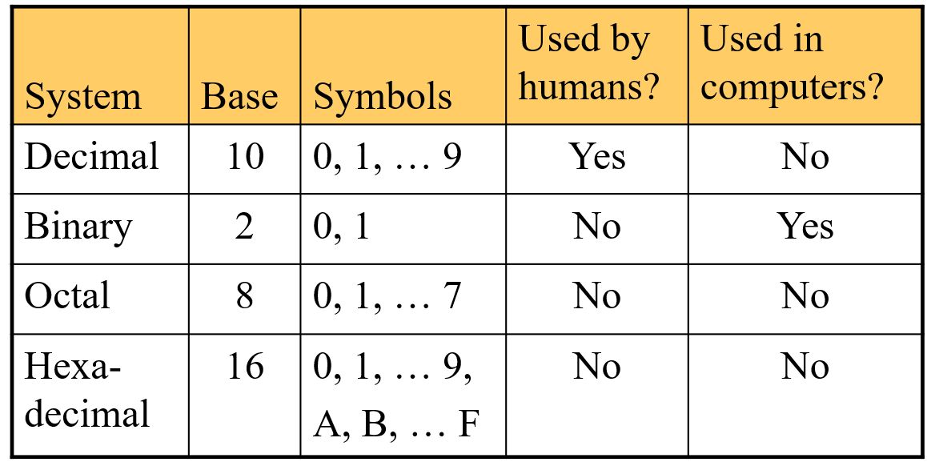
Number systems
Lecturer Saifur Rahman, Dept. of CSE, United International University

Slide 4
Why binary?
Major computer components (CPU, RAM etc.) are made of transistors
A transistor is an electronic switch
Has two states – on (1) and off (0)
This is why a computer understands the language of 1’s and 0’s only
Binary number system
Every instruction of a computer is encoded in binary
Every data is also encoded in binary
Computer stores and manipulates these data in binary format
Lecturer Saifur Rahman, Dept. of CSE, United International University

Slide 5
Why octal and hexadecimal?
Even a small number requires quite a few bits in binary system
The decimal number 93 is 1011101 in binary
Converting decimal into binary is troublesome
We will learn in a while
Octal and hexadecimal are simplified binary numbers, so conversion is fairly easy
We will also learn in a while
Lecturer Saifur Rahman, Dept. of CSE, United International University

Slide 6
Numbers in different systems
Decimal | Binary | Octal | Hexadec.
0 | 0 | 0 | 0
1 | 1 | 1 | 1
2 | 10 | 2 | 2
3 | 11 | 3 | 3
4 | 100 | 4 | 4
5 | 101 | 5 | 5
6 | 110 | 6 | 6
7 | 111 | 7 | 7
8 | 1000 | 10 | 8
9 | 1001 | 11 | 9
Decimal | Binary | Octal | Hexadec.
10 | 1010 | 12 | A
11 | 1011 | 13 | B
12 | 1100 | 14 | C
13 | 1101 | 15 | D
14 | 1110 | 16 | E
15 | 1111 | 17 | F
16 | 10000 | 20 | 10
17 | 10001 | 21 | 11
18 | 10010 | 22 | 12
19 | 10011 | 23 | 13
Lecturer Saifur Rahman, Dept. of CSE, United International University

Slide 7
bytes and larger units
8 bits together – a byte
A number of bytes together – a word
Usually 4 or 8 bytes, depending on the processor, computer architecture etc.
Kilobyte – 1024 bytes
Megabyte – 1024 kilobytes
Gigabyte – 1024 megabytes
Terabyte – 1024 gigabytes
Why 1024 instead of 1000?
Lecturer Saifur Rahman, Dept. of CSE, United International University

Slide 8
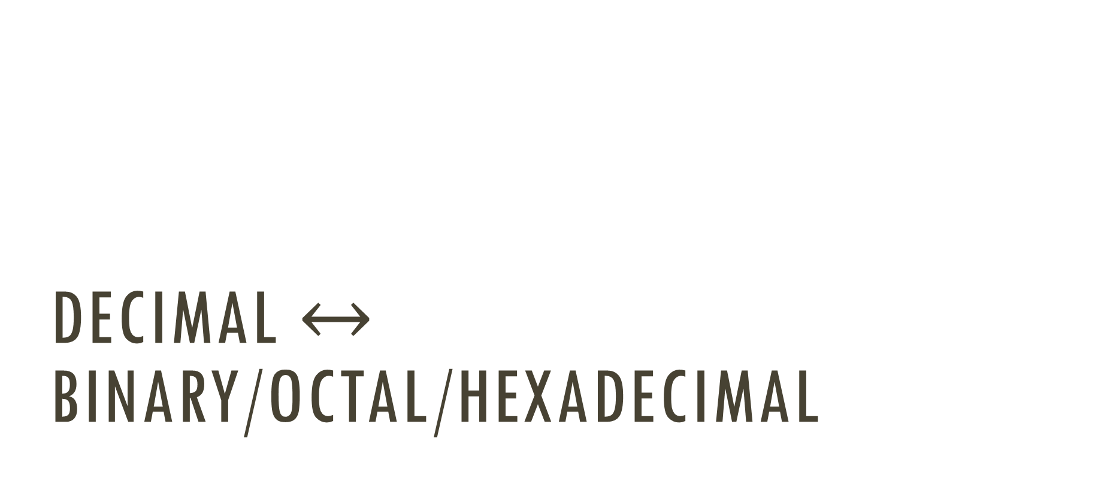
Decimal $↔$ binary/octal/hexadecimal
Lecturer Saifur Rahman, Dept. of CSE, United International University

Slide 9
Decimal to Binary
Technique
Divide by two, keep track of the remainder
First remainder is bit 0 (LSB, least-significant bit)
Second remainder is bit 1
Etc.
Lecturer Saifur Rahman, Dept. of CSE, United International University

Slide 10

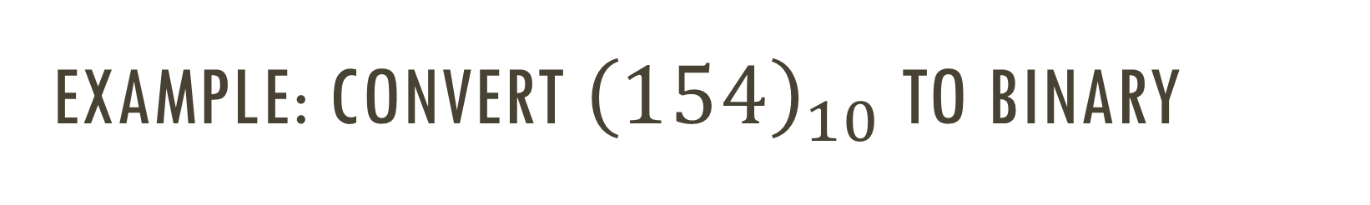
Example: Convert ${\left(154\right)}_{10}$ to binary
Quotient
Remainder
2
154
2
77 0
$${\left(154\right)}_{10}={\left(10011010\right)}_{2}$$
2
38 1
2
19 0
2
9 1
2
4 1
2
2 0
2
1 0
0 1
Lecturer Saifur Rahman, Dept. of CSE, United International University

Slide 11


Example: Convert ${\left(0.625\right)}_{10}$ to binary
Integer
Fraction
-
.625
x2
1
.250
x2
$${\left(0.625\right)}_{10}={\left(0.101\right)}_{2}$$
0
.500
x2
1
.000
Lecturer Saifur Rahman, Dept. of CSE, United International University

Slide 12

Merging these two
To convert ${\left(154.625\right)}_{10}$ to binary –
Divide the number into integer and fraction part, i.e. ${\left(154\right)}_{10}$ and ${\left(0.625\right)}_{10}$
Convert them individually to binary
Join them up
${\left(154.625\right)}_{10}={\left(10011010.101\right)}_{2}$
Lecturer Saifur Rahman, Dept. of CSE, United International University

Slide 13
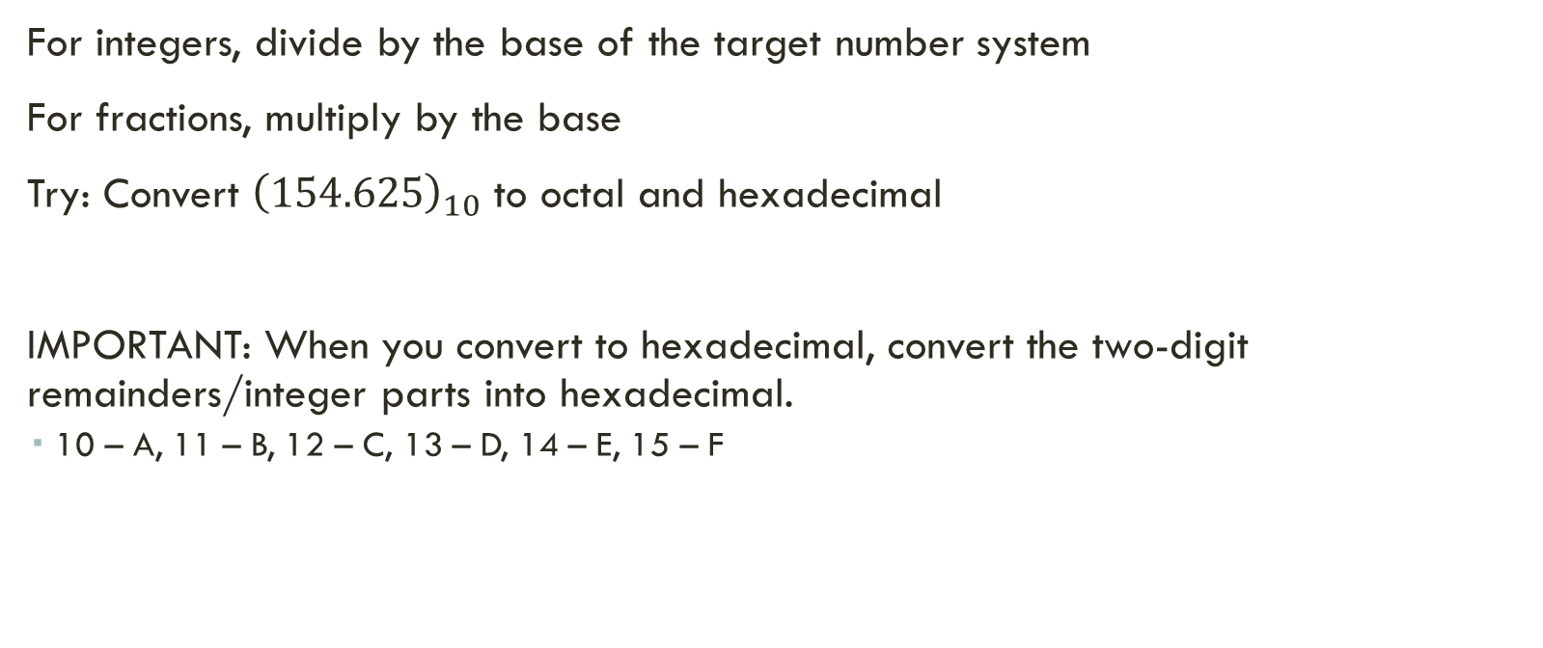
Same way for octal and hexadecimal
For integers, divide by the base of the target number system
For fractions, multiply by the base
Try: Convert ${\left(154.625\right)}_{10}$ to octal and hexadecimal
IMPORTANT: When you convert to hexadecimal, convert the two-digit remainders/integer parts into hexadecimal.
10 – A, 11 – B, 12 – C, 13 – D, 14 – E, 15 – F
Lecturer Saifur Rahman, Dept. of CSE, United International University

Slide 14

Reverse action: Binary to Decimal
Multiply each bit with the place value of its place value, and sum the results
Place values –
$$2^{6}$$ | $$2^{5}$$ | $$2^{4}$$ | $$2^{3}$$ | $$2^{2}$$ | $$2^{1}$$ | $$2^{0}$$
$$2^{−1}$$ | $$2^{−2}$$ | $$2^{−3}$$ | $$2^{−4}$$
Lecturer Saifur Rahman, Dept. of CSE, United International University

Slide 15
Binary to Decimal
Technique
Multiply each bit by 2^{n}, where n is the “weight” of the bit
The weight is the position of the bit, starting from 0 on the right
Add the results
Lecturer Saifur Rahman, Dept. of CSE, United International University

Slide 16
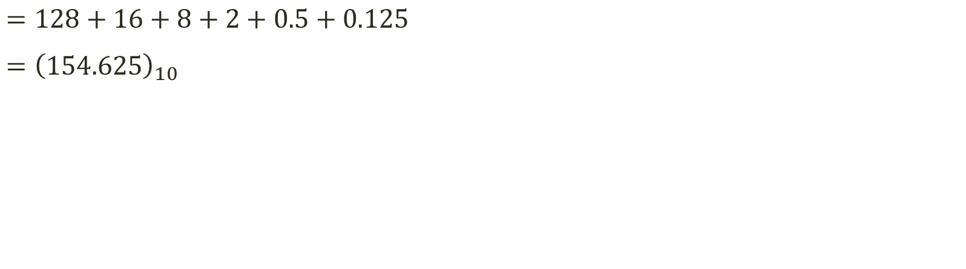

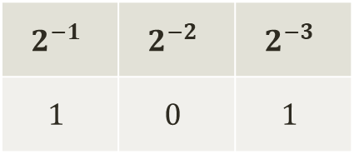
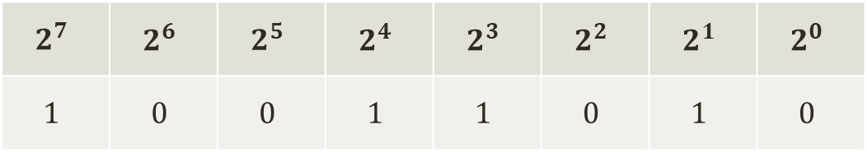
Convert ${\left(10011010.101\right)}_{2}$ to decimal
$$2^{7}$$ | $$2^{6}$$ | $$2^{5}$$ | $$2^{4}$$ | $$2^{3}$$ | $$2^{2}$$ | $$2^{1}$$ | $$2^{0}$$
$$1$$ | $$0$$ | $$0$$ | $$1$$ | $$1$$ | $$0$$ | $$1$$ | $$0$$
$$2^{−1}$$ | $$2^{−2}$$ | $$2^{−3}$$
$$1$$ | $$0$$ | $$1$$
$=128+16+8+2+0.5+0.125$
$={\left(154.625\right)}_{10}$
Lecturer Saifur Rahman, Dept. of CSE, United International University

Slide 17
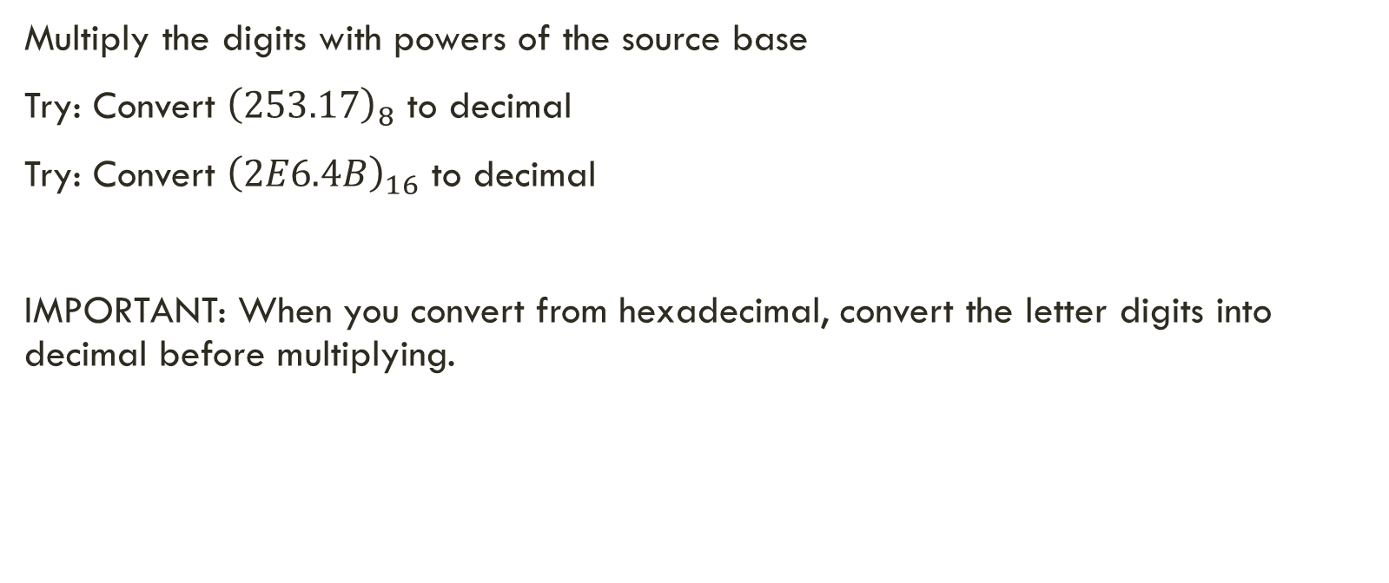
Same way for octal and hexadecimal
Multiply the digits with powers of the source base
Try: Convert ${\left(253.17\right)}_{8}$ to decimal
Try: Convert ${\left(2E6.4B\right)}_{16}$ to decimal
IMPORTANT: When you convert from hexadecimal, convert the letter digits into decimal before multiplying.
Lecturer Saifur Rahman, Dept. of CSE, United International University

Slide 18
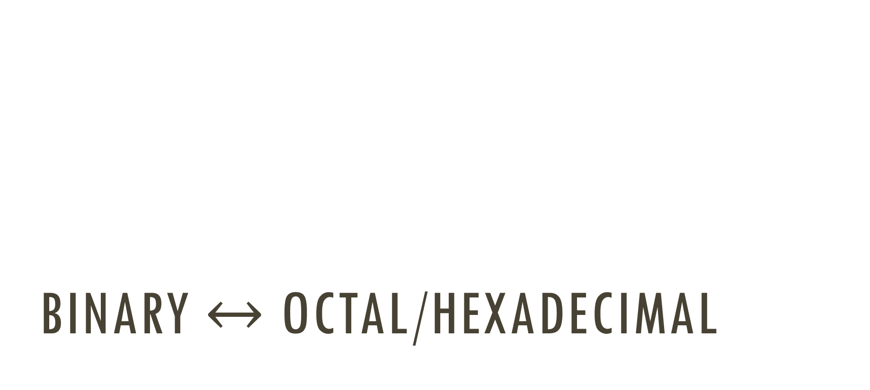
Binary $↔$ Octal/Hexadecimal
Lecturer Saifur Rahman, Dept. of CSE, United International University

Slide 19
Binary to Octal
Technique
Group bits in threes, starting on right
Convert to octal digits
Lecturer Saifur Rahman, Dept. of CSE, United International University

Slide 20






Binary to octal
Group the bits into groups of 3, and convert each group into an octal digit
${\left(10110101.1111\right)}_{2}={\left(?\right)}_{8}$
$$010 110 101 . 111 100$$
Grouped from the right
Grouped from the left
Padding by 0 for grouping
Padding by 0 for grouping
$$2$$
$$6$$
$$5$$
$$7$$
$$4$$
$$∴{\left(10110101.1111\right)}_{2}={\left(265.74\right)}_{8}$$
Lecturer Saifur Rahman, Dept. of CSE, United International University

Slide 21
Binary to Hexadecimal
Technique
Group bits in fours, starting on right
Convert to hexadecimal digits
Lecturer Saifur Rahman, Dept. of CSE, United International University

Slide 22



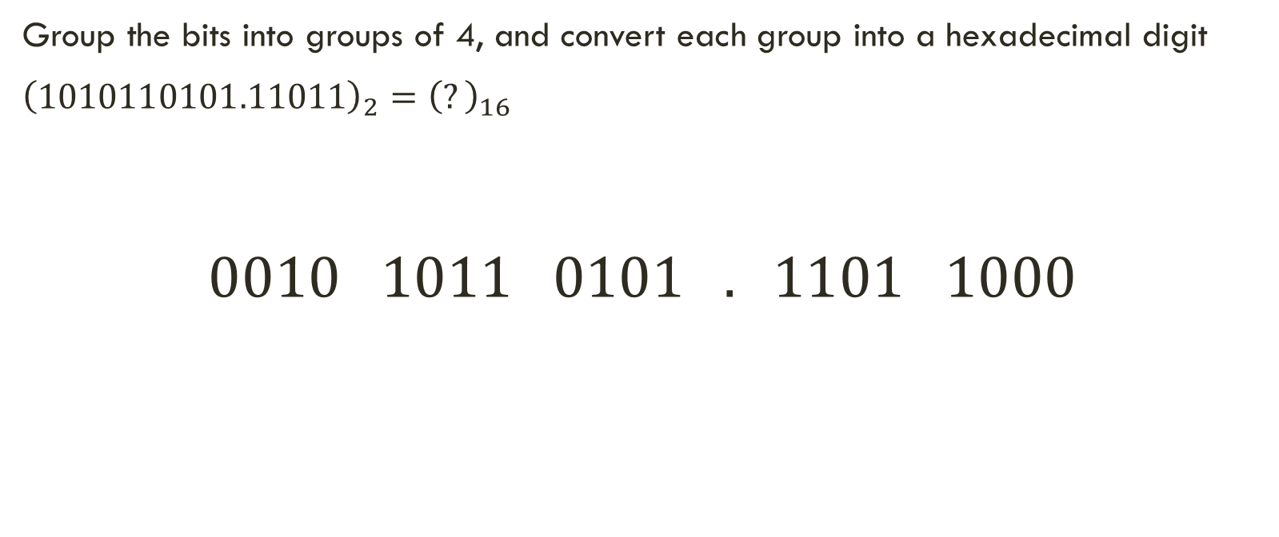


Binary to hexadecimal
Group the bits into groups of 4, and convert each group into a hexadecimal digit
${\left(1010110101.11011\right)}_{2}={\left(?\right)}_{16}$
$$0010 1011 0101 . 1101 1000$$
$$2$$
$$B$$
$$5$$
$$D$$
$$8$$
$$∴{\left(1010110101.11011\right)}_{2}={\left(2B5.D8\right)}_{16}$$
Lecturer Saifur Rahman, Dept. of CSE, United International University

Slide 23
Octal to Binary
Technique
Convert each octal digit to a 3-bit equivalent binary representation
Lecturer Saifur Rahman, Dept. of CSE, United International University

Slide 24
Hexadecimal to Binary
Technique
Convert each hexadecimal digit to a 4-bit equivalent binary representation
Lecturer Saifur Rahman, Dept. of CSE, United International University

Slide 25
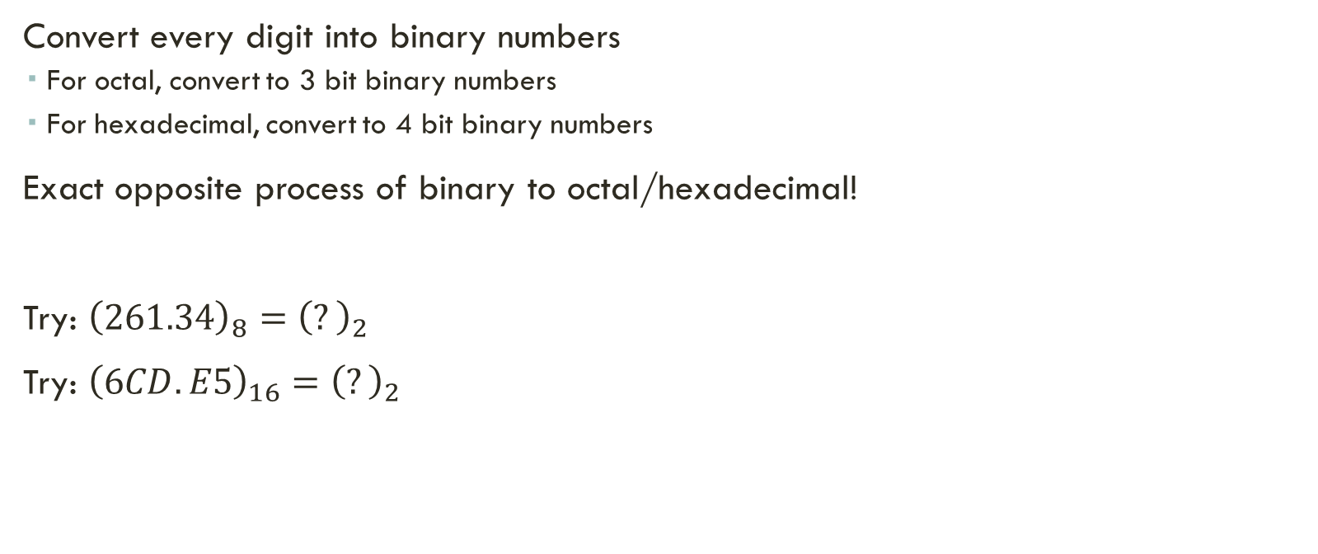
Octal/hexadecimal to binary
Convert every digit into binary numbers
For octal, convert to 3 bit binary numbers
For hexadecimal, convert to 4 bit binary numbers
Exact opposite process of binary to octal/hexadecimal!
Try: ${\left(261.34\right)}_{8}={\left(?\right)}_{2}$
Try: ${\left(6CD.E5\right)}_{16}={\left(?\right)}_{2}$
Lecturer Saifur Rahman, Dept. of CSE, United International University

Slide 26
Exercise – Convert ...
Decimal | Binary | Octal | Hexa- decimal
33
 | 1110101
 |  | 703
 |  |  | 1AF
Lecturer Saifur Rahman, Dept. of CSE, United International University

Slide 27
Exercise – Convert …
Answer
Decimal | Binary | Octal | Hexa- decimal
33 | 100001 | 41 | 21
117 | 1110101 | 165 | 75
451 | 111000011 | 703 | 1C3
431 | 110101111 | 657 | 1AF
Lecturer Saifur Rahman, Dept. of CSE, United International University

Slide 28
Exercise – Convert ...
Decimal | Binary | Octal | Hexa- decimal
29.8
 | 101.1101
 |  | 3.07
 |  |  | C.82
Lecturer Saifur Rahman, Dept. of CSE, United International University

Slide 29
Exercise – Convert …
Answer
Decimal | Binary | Octal | Hexa- decimal
29.8 | 11101.110011… | 35.63… | 1D.CC…
5.8125 | 101.1101 | 5.64 | 5.D
3.109375 | 11.000111 | 3.07 | 3.1C
12.5078125 | 1100.10000010 | 14.404 | C.82
Lecturer Saifur Rahman, Dept. of CSE, United International University

Slide 30
Basic binary addition
Lecturer Saifur Rahman, Dept. of CSE, United International University

Slide 31
Adding two binary numbers
0101 + 0111 = 1100
0101 + 1011 = 10000
0111 + 0011 = 1010
How is it done?
Watch carefully …
Lecturer Saifur Rahman, Dept. of CSE, United International University

Slide 32
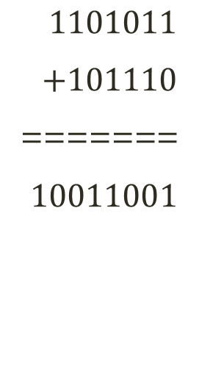
Adding two binary numbers
$1101011$
$+101110$
=======
$10011001$
1
1
1
1
1
1
1
0
1
0
1
1
+
1
0
1
1
1
0
1
0
0
1
1
0
0
1
Lecturer Saifur Rahman, Dept. of CSE, United International University

Slide 33
Thank You

